Slide 1
COMP6049 – Algorithm Design and Analysis
Topic 23-24 – Strongly Connected Components

Slide 2
Outline Materials
Definition of Connected Components
Revisit DFS/BFS to find connected components
Definition of Strongly Connected Components
Tarjan’s Strongly Connected Components Algorithm

Slide 3
Connected Components

Slide 4
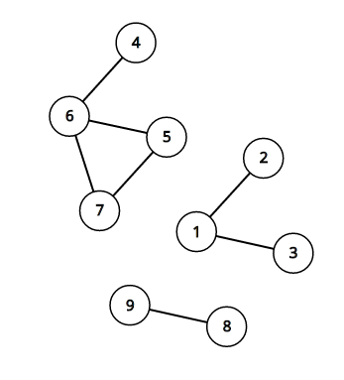
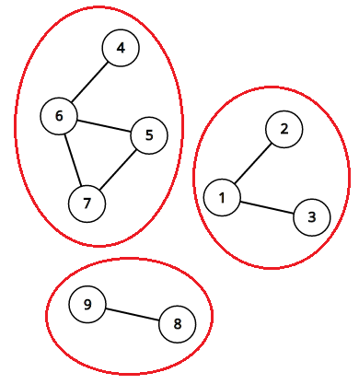
Connected Components
An undirected graph can be partitioned into several connected components
A connected component is a maximal subset of the vertices such that each pair of vertices is reachable from each other
An undirected graph with 3 connected components
An undirected graph with 3 connected components

Slide 5
Connected Components
We can find these components using depth-first search or breadth-first search.
Algorithm Steps
Choose Vertex. Pick some vertex that we don’t know anything about and do a depth-first or bread-first search out from it.
Traverse the Graph. All vertices that can be reached from that starting vertex are belong to the same component.
Repeat Process. Repeat this process for the remaining unvisited vertices until all vertices are visited and you will have all the components from that graph.
Time complexity is O( V+E ), where V is the number of vertices and E is the number of edges.

Slide 6
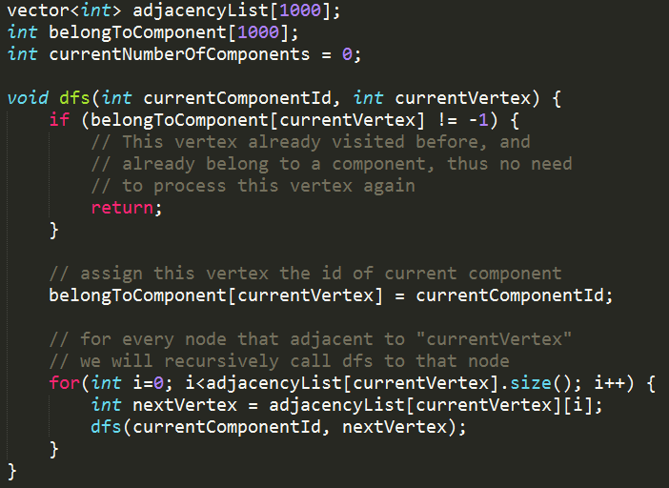
Connected Components

Slide 7
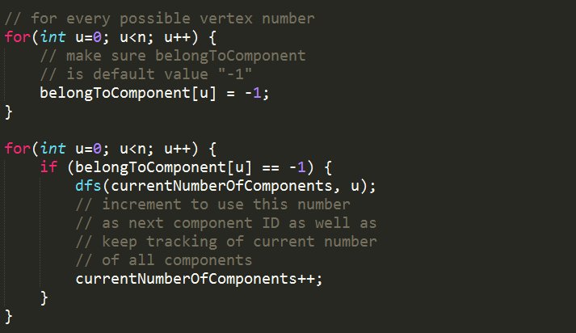
Connected Components

Slide 8
Strongly Connected Components (SCC)

Slide 9
Strongly Connected Components
Definitions
The definition of “Strongly Connected Components” is the same as “Connected Components” for undirected graph.
A strongly connected component is a maximal subset of the vertices such that each pair of the vertices in that component is reachable from each other.
Disavowal
Nevertheless, the connected component algorithm (normal DFS-like) won’t work for this problem.

Slide 10
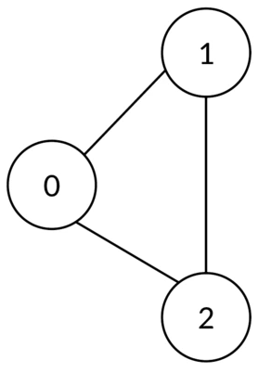
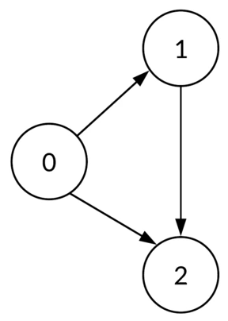
Strongly Connected Components
How about directed graph?
Components behave differently in directed graphs. Because if v can be reached by u, it doesn’t mean that u can be reached by v.
v
u
w
Undirected Graph
Directed Graph

Slide 11
Tarjan’s Strongly Connected Components Algorithm

Slide 12
Tarjan’s SCC Algorithm
Published in 1972 by Robert Tarjan
Characteristics of Tarjan’s SCC Algorithm
Single Pass. Performs a single pass of depth-first search.
Stack of Vertices. It maintains a stack of vertices that have been explored by the depth-first search but not yet assigned to a component.
Low-Link Values. It calculates “low numbers” of each vertex which it uses to determine when a set of vertices should be popped off the stack to a new component.
Ancestor Group. “low numbers” is an index number of the highest ancestor reachable in one step from a descendant of the vertex.

Slide 13
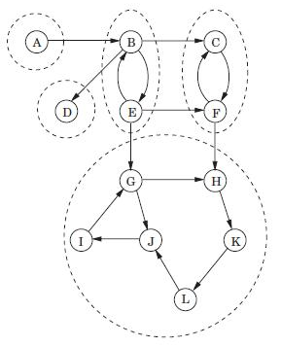
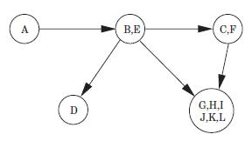
Tarjan’s SCC Algorithm Example 1
A directed graph with its Strongly Connected Component
The meta graph that shows we can “shrink” some nodes to just a node

Slide 14
Tarjan’s SCC Algorithm Example 2

Slide 15
Tarjan’s SCC Algorithm Example 2

Slide 16
Tarjan’s SCC Algorithm Overview
Initialization. Mark the id of each node as unvisited.
Start DFS. Upon visiting a node assign it an id and a low-link value. Also mark current nodes as visited and add them to a seen stack.
DFS Callback. On DFS callback, if the previous node is on the stack, then min the current node's low-link value with the last node's low—link value⁽¹⁾.
Pop Stack. After visiting all neighbors, if the current node started a connected component⁽²⁾ then pop nodes off stack until current node is reached.
⁽¹⁾ This allows low—link values to propagate throughout cycles.
⁽²⁾ As we will see, a node started a connected component if its id equals its low link value.

Slide 17
Low-Link Values

Slide 18
Low-Link Values
Definition. The low-link values of a node is the smallest [lowest] node id reachable from that node when doing a DFS (including itself).
0
1
4
0
1
4
5
5
6
6
2
3
2
3

Slide 19
Low-Link Values
Definition. The low-link values of a node is the smallest [lowest] node id reachable from that node when doing a DFS (including itself).
0
0
4
0
1
4
5
5
0
6
2
3
2
3

Slide 20
Low-Link Values
Definition. The low-link values of a node is the smallest [lowest] node id reachable from that node when doing a DFS (including itself).
0
0
4
0
1
4
5
5
0
6
2
3
2
2

Slide 21
Low-Link Values
Definition. The low-link values of a node is the smallest [lowest] node id reachable from that node when doing a DFS (including itself).
0
0
4
0
1
4
4
5
0
6
2
3
2
2

Slide 22
Low-Link Values
Ancestor Group. “low numbers” is an index number of the highest ancestor reachable in one step from a descendant of the vertex.
0
0
4
0
1
4
4
5
0
6
2
3
2
2

Slide 23
Low-Link Values Update Condition

Slide 24
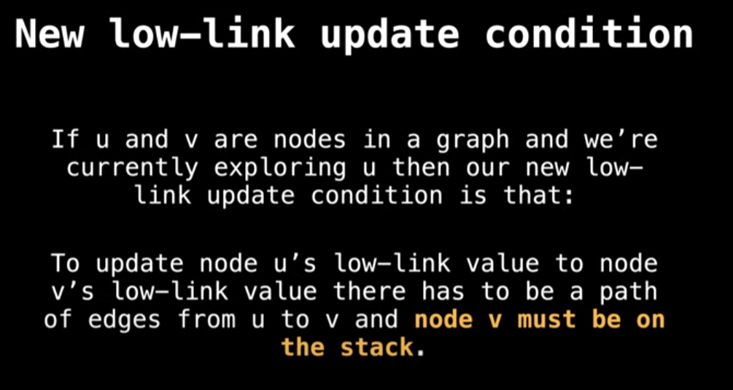

Slide 25
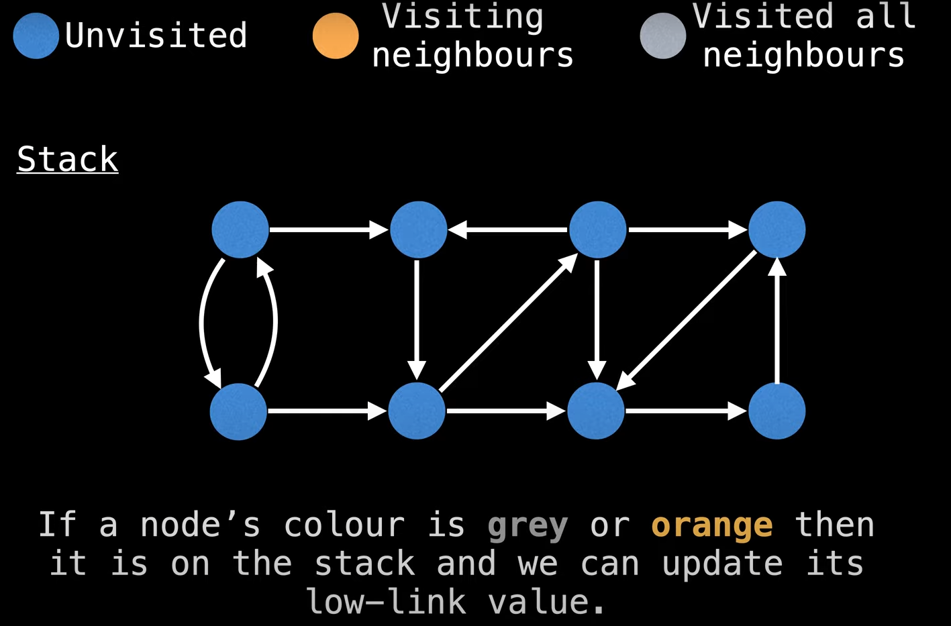
Starting Graph

Slide 26
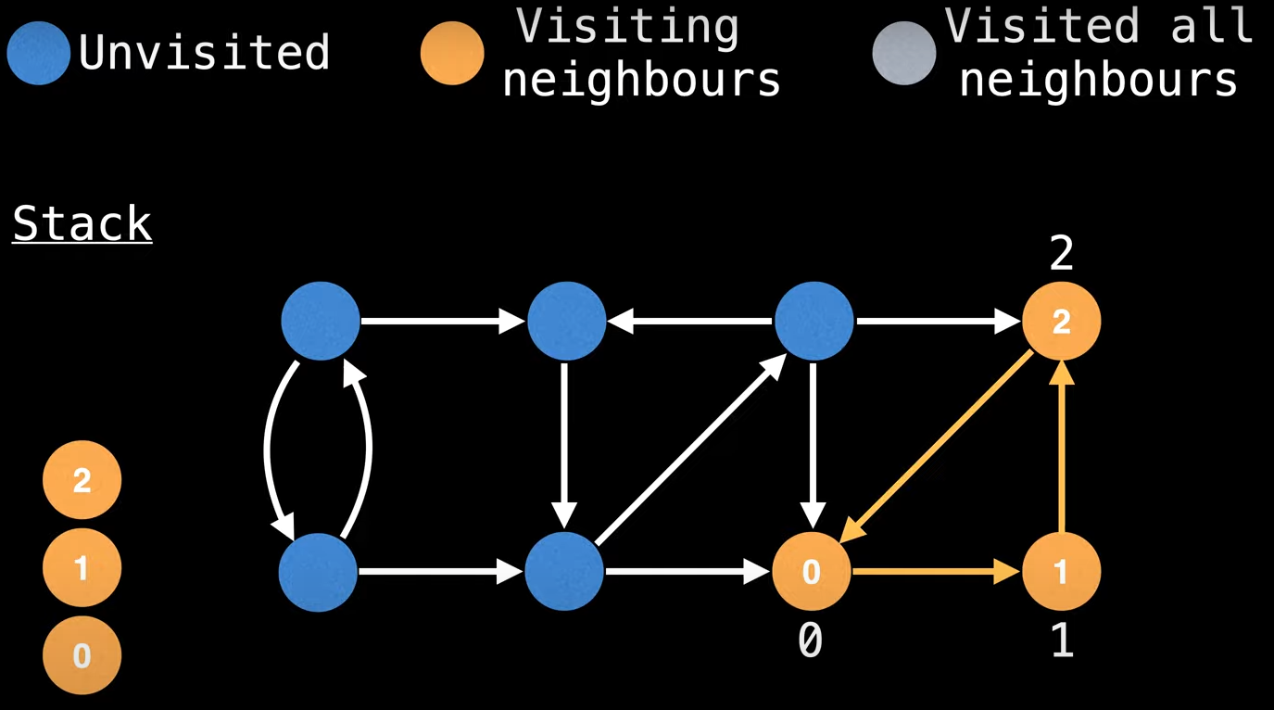
Perform DFS, assign ID 0 → 1 → 2

Slide 27
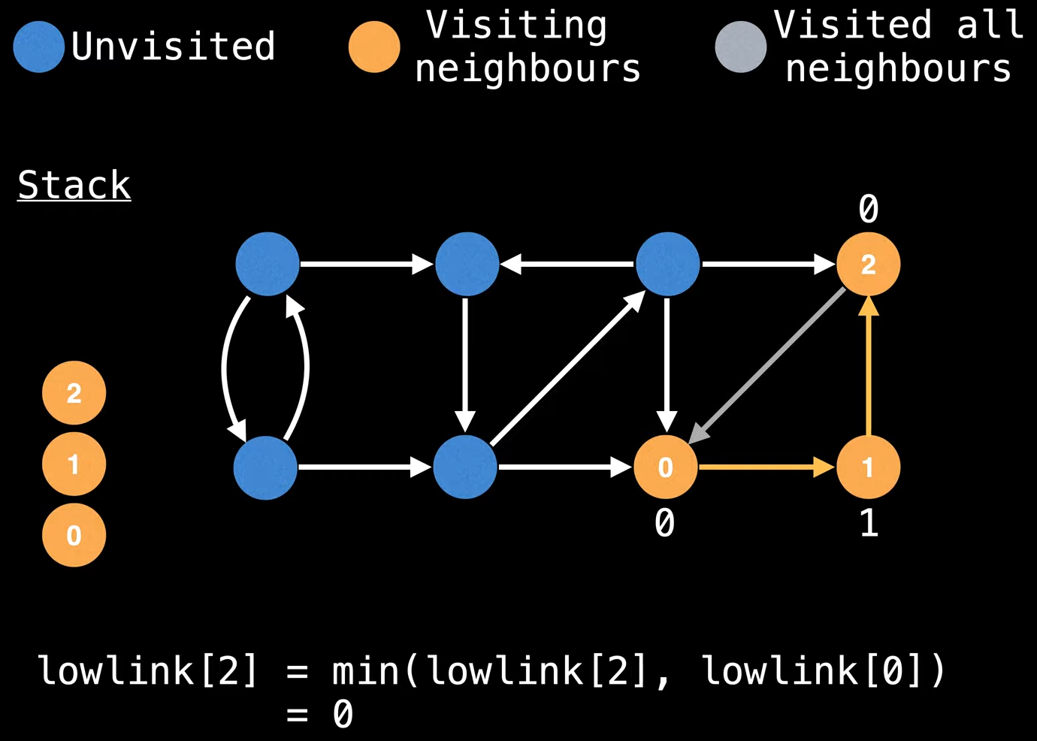
Backtrack, because node 0 already visited, then calculate lowlink

Slide 28
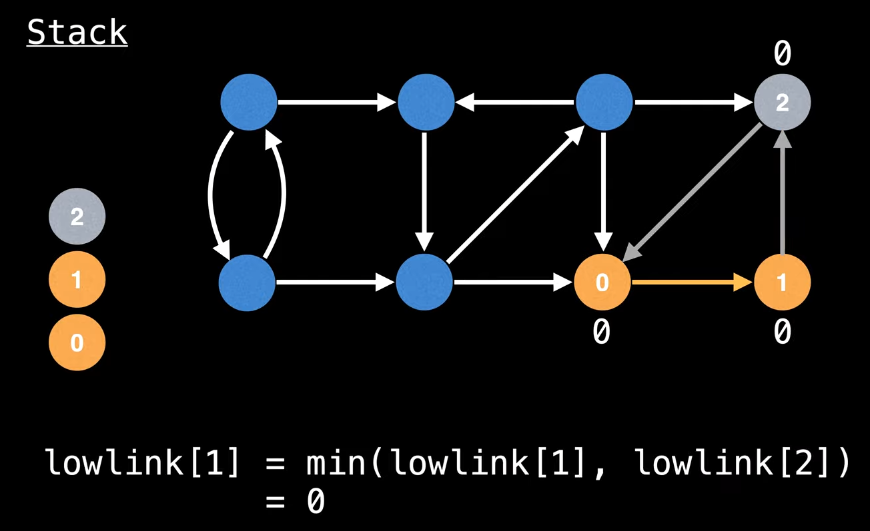
Calculate lowlink

Slide 29
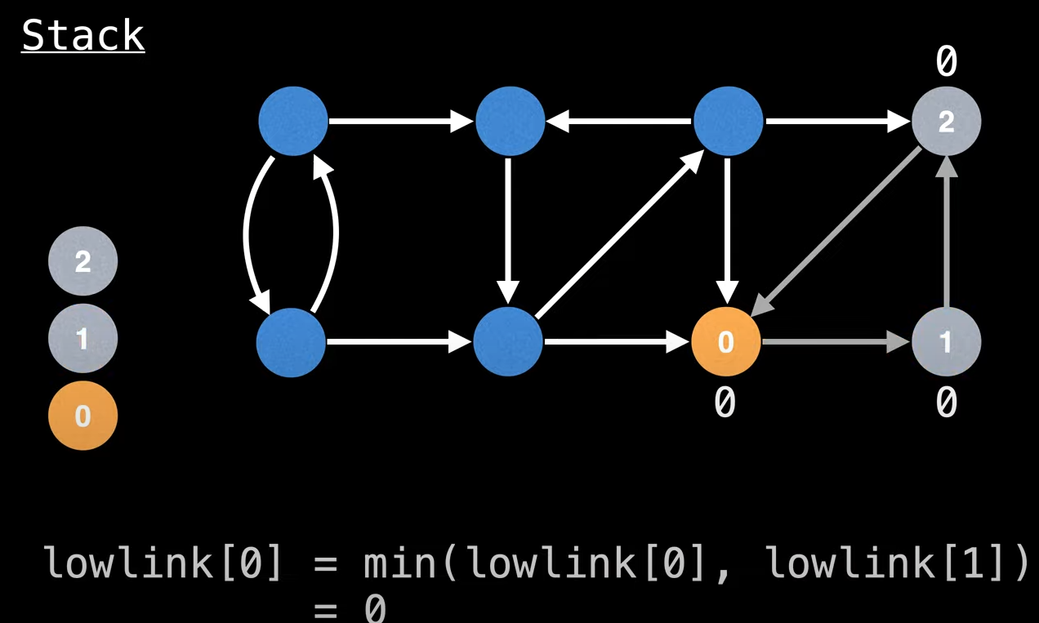
Calculate lowlink

Slide 30
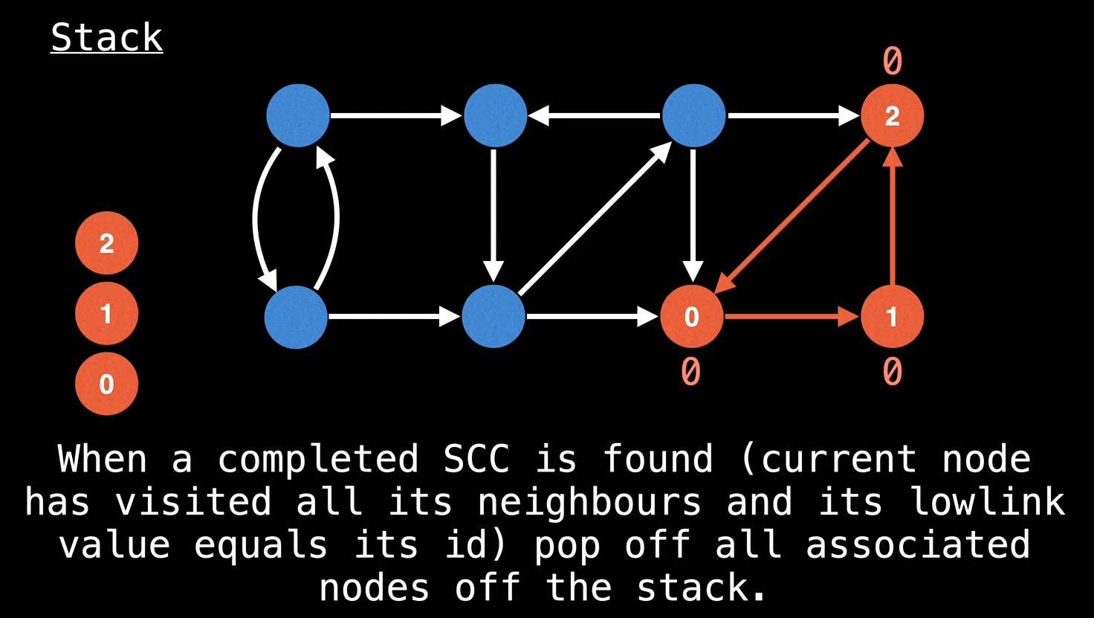
Completed SCC, pop all nodes in the stack

Slide 31
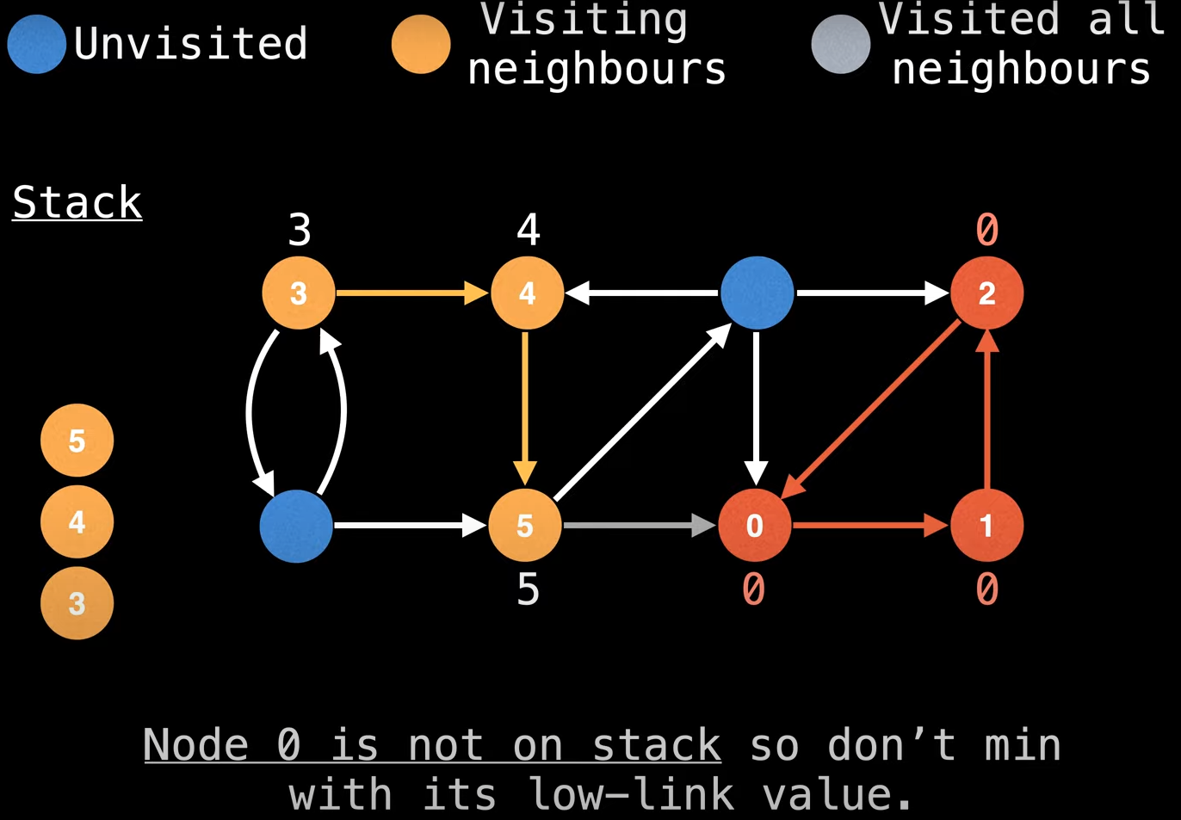
Start from a random node 3 → 4 → 5 → cannot go to node 0

Slide 32
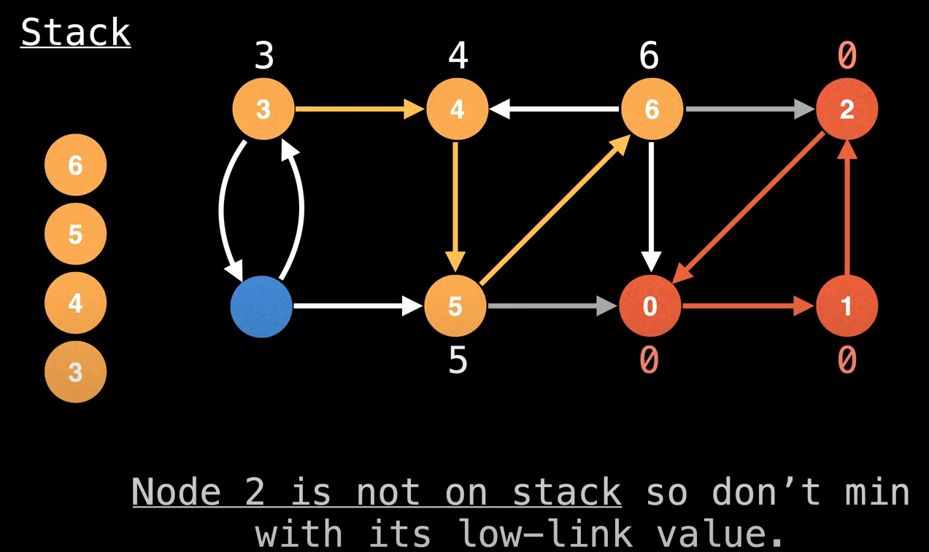
Node 2 is not in the stack

Slide 33
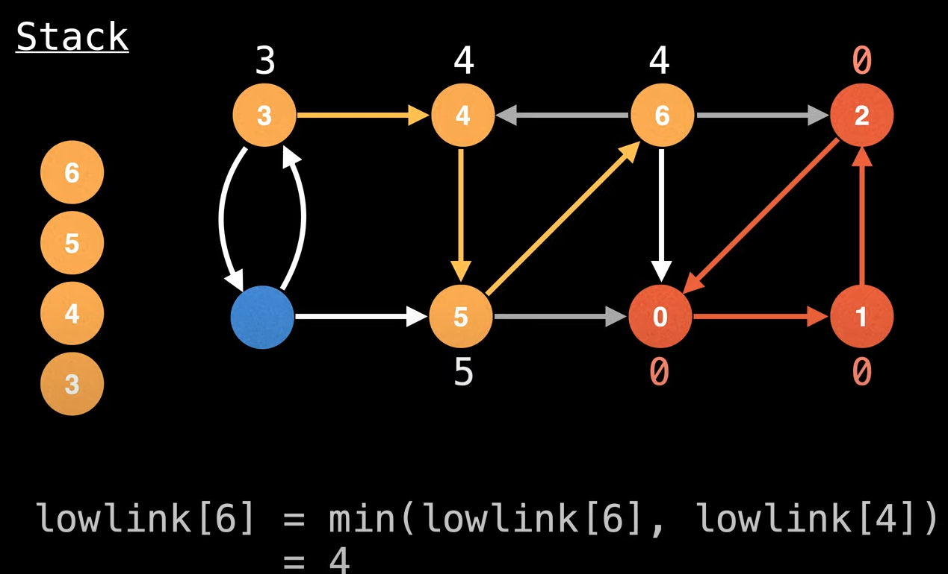
Calculate lowlink node 6

Slide 34
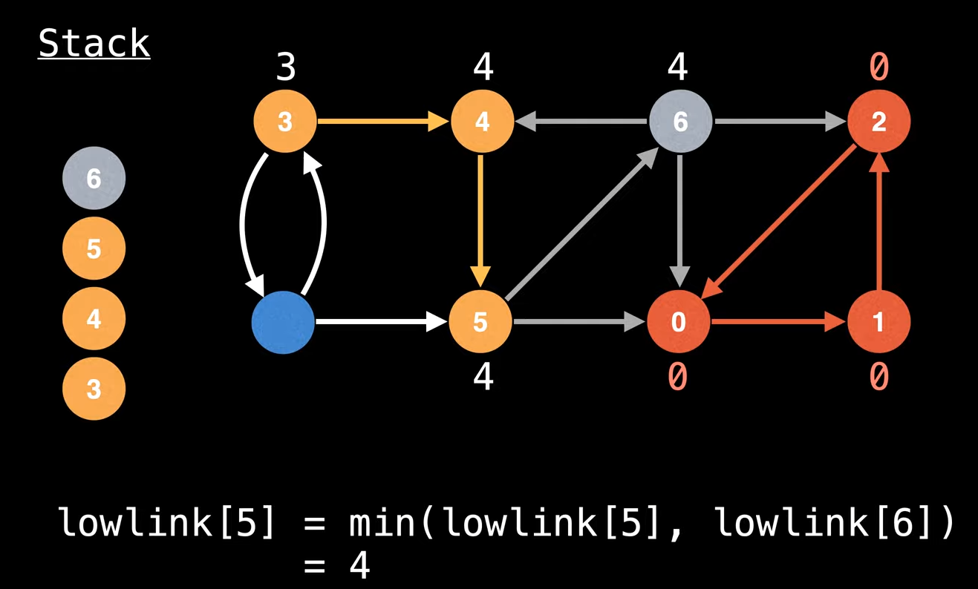
Calculate lowlink node 5

Slide 35
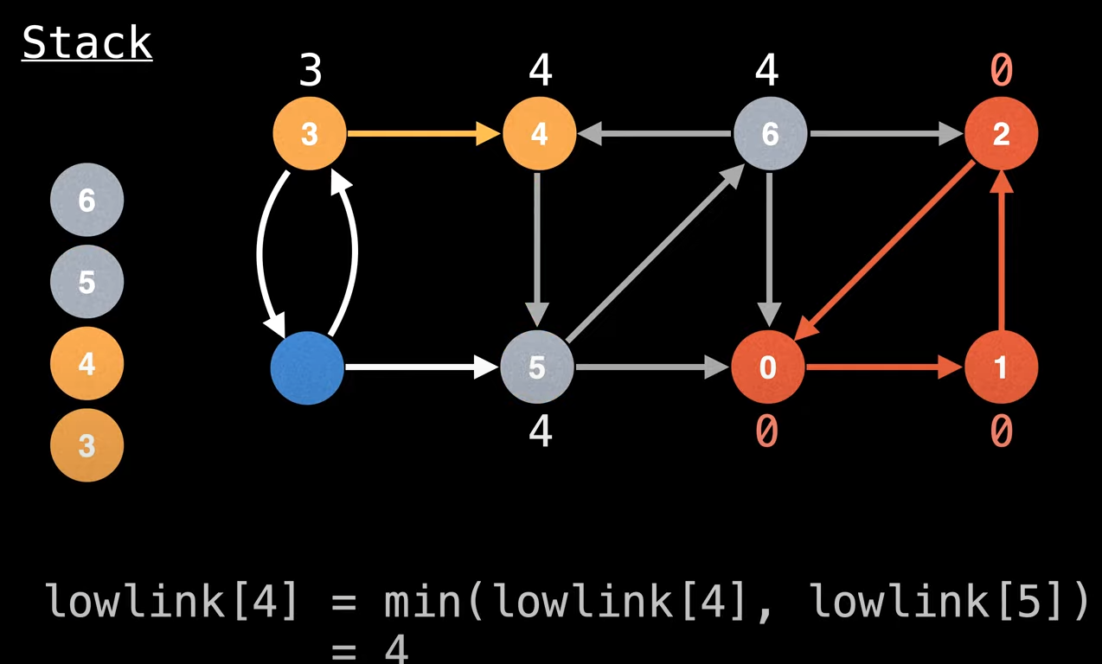
Calculate lowlink node 4

Slide 36
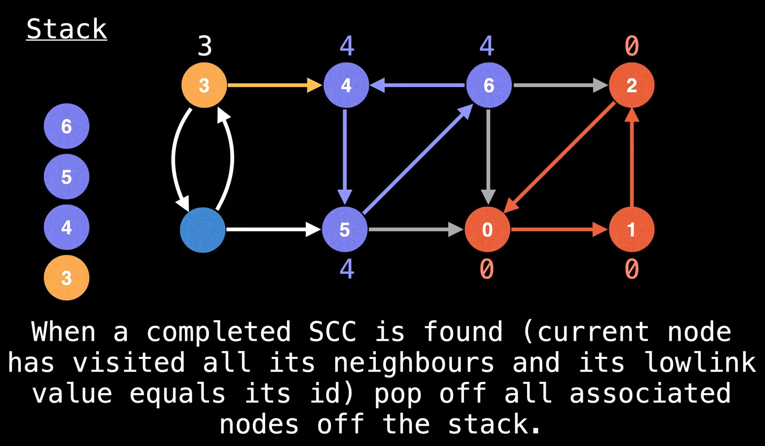
Completed second SCC

Slide 37
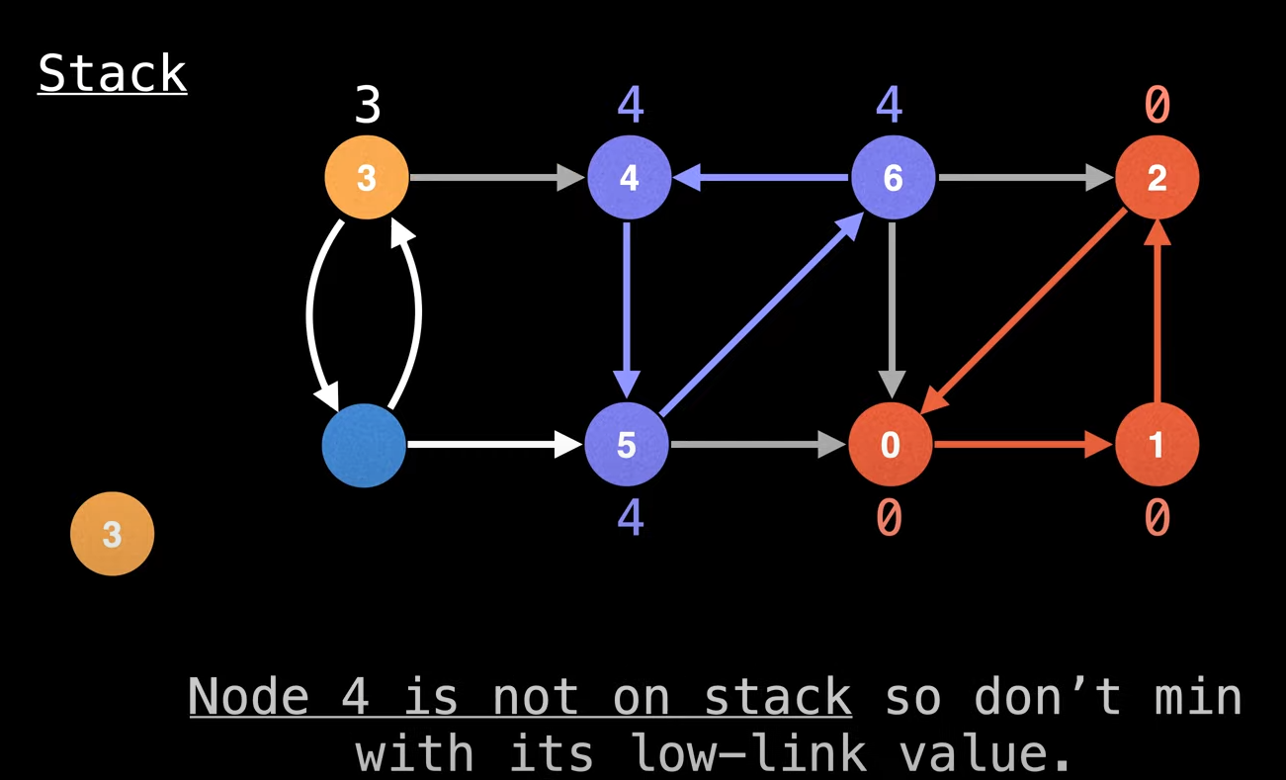
Remove all nodes of SCC #2 from the stack

Slide 38
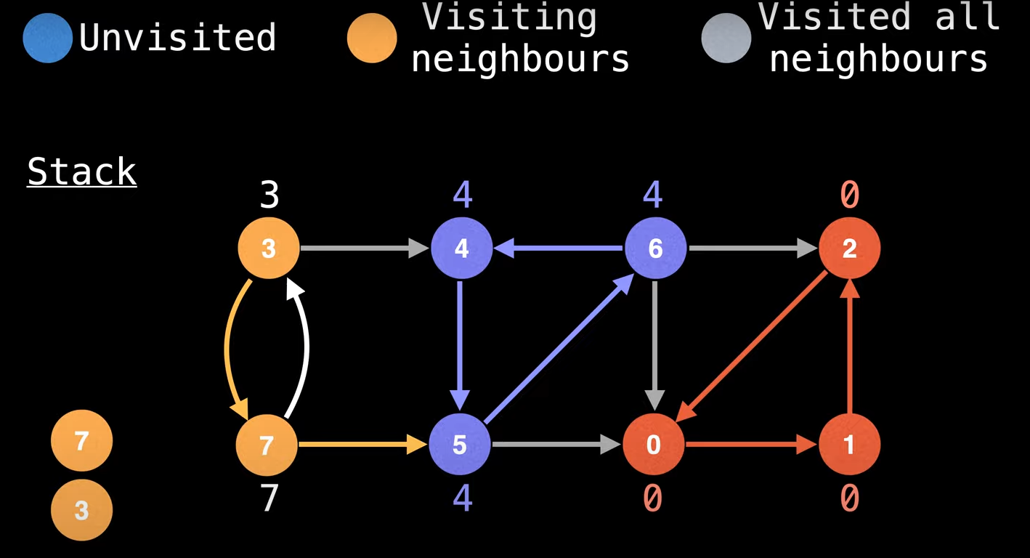

Slide 39
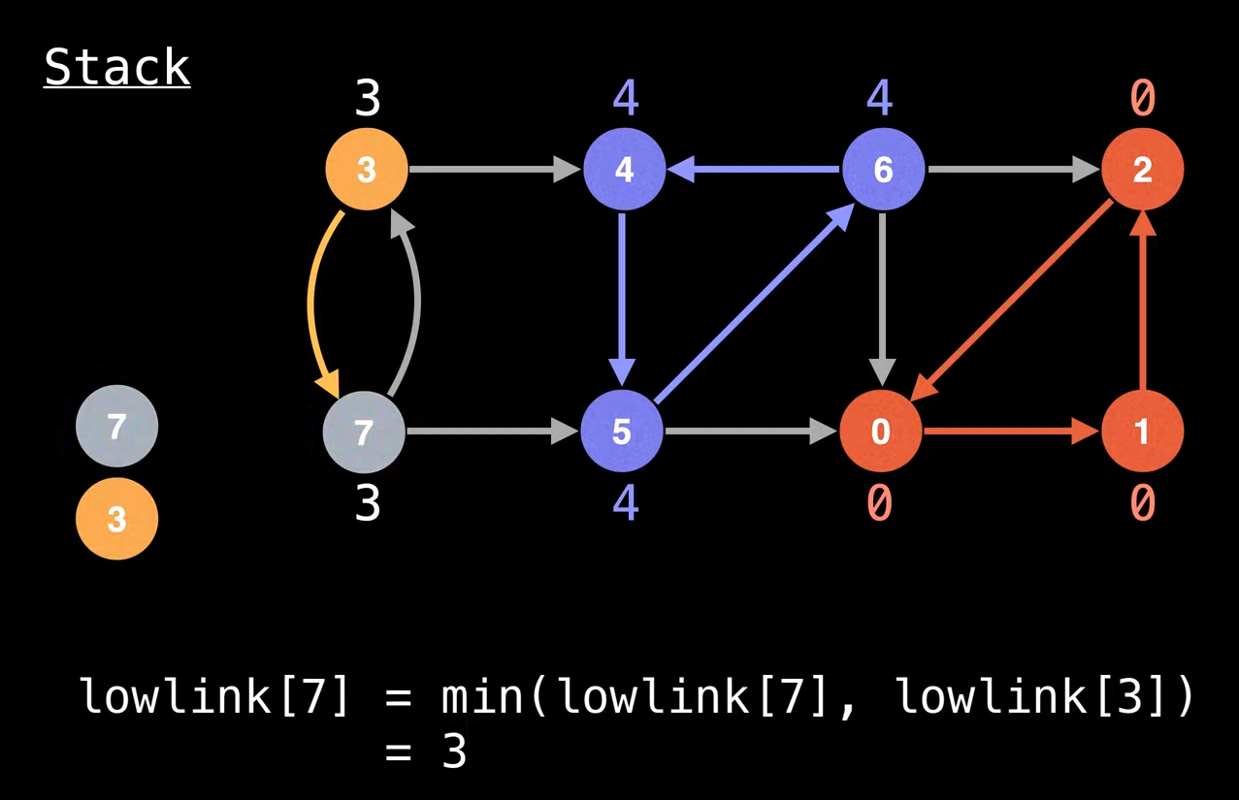
Calculate lowlink 7

Slide 40
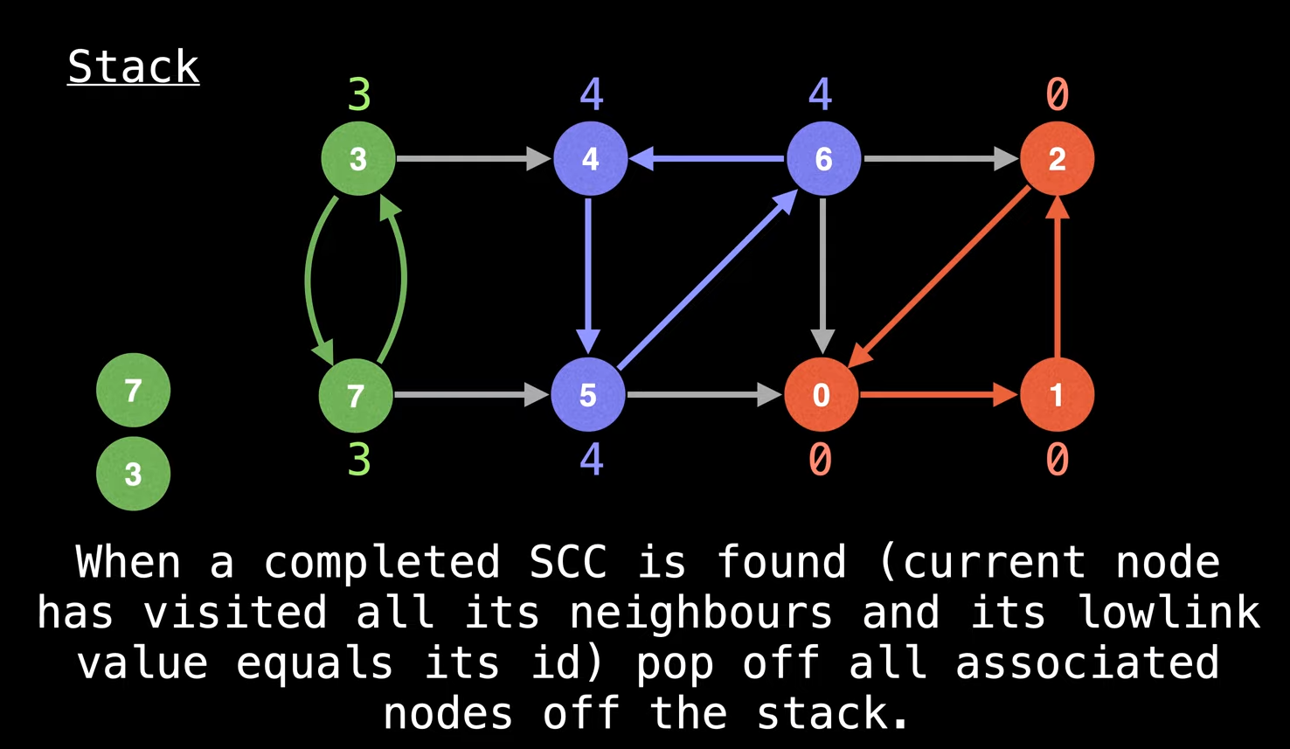
The 3rd SCC

Slide 41
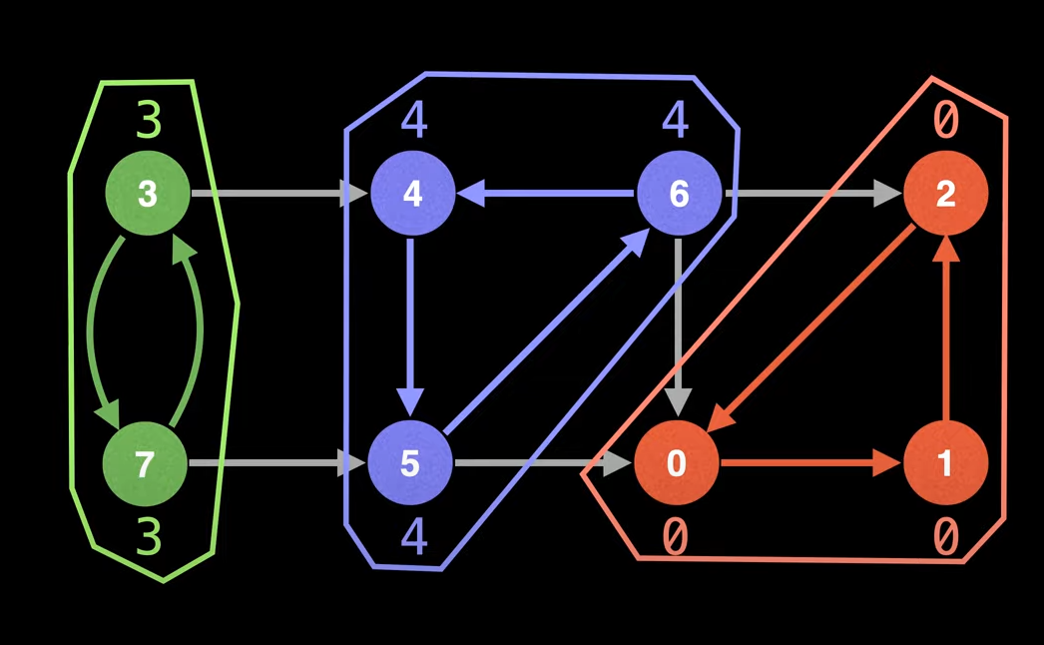
Completed SCC

Slide 42
Q & A

Slide 43
References
Thomas H. Cormen. 2009. Introduction to algorithms. TMP. London. ISBN:9780262033848. Chapter 22
Strongly Connected Components Algorithm http://visualgo.net/en/dfsbfs
Graphs – Unweighted Graphs https://algo.is/aflv16/aflv_07_graphs_1.pdf

Slide 44
THANK YOU

Slide 45
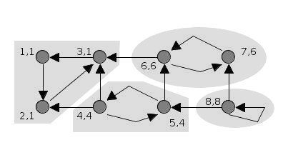
Tarjan’s SCC Algorithm
This is a gif image
(x,y) = (id, and assign a low-link value)

Slide 46
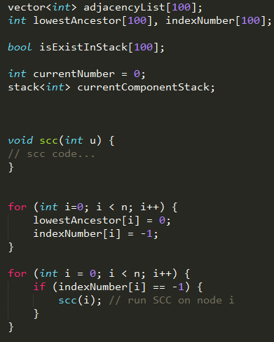
Tarjan’s SCC Algorithm

Slide 47
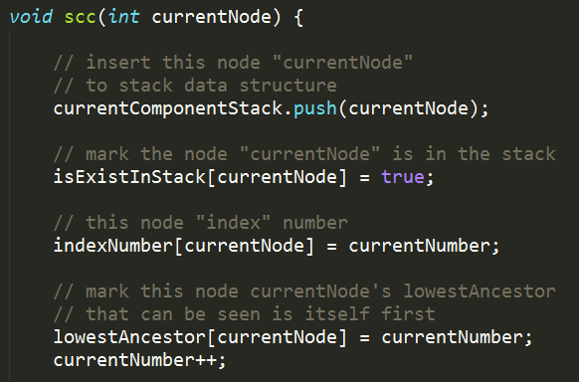
Tarjan’s SCC Algorithm

Slide 48
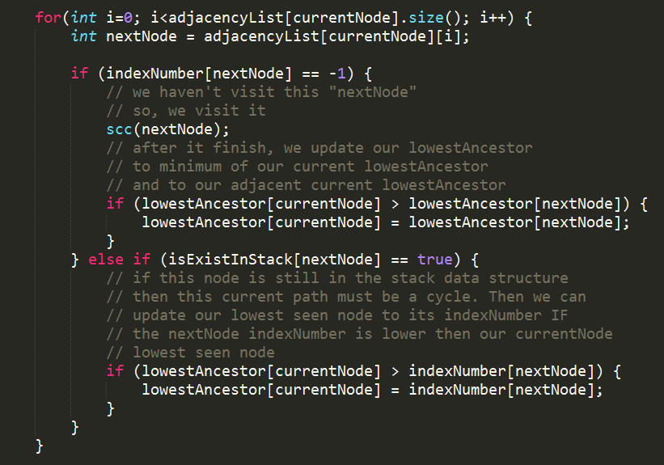
Tarjan’s SCC Algorithm

Slide 49
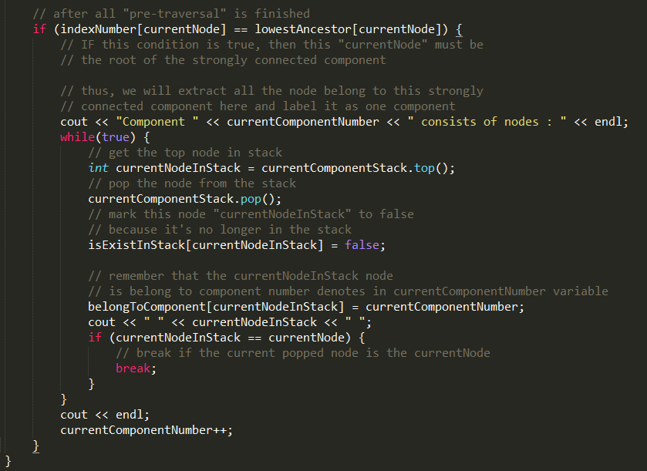
Tarjan’s SCC Algorithm

Slide 50
Tarjan’s SCC Algorithm
The above code assumes that the adjacency list has been filled.

Slide 51
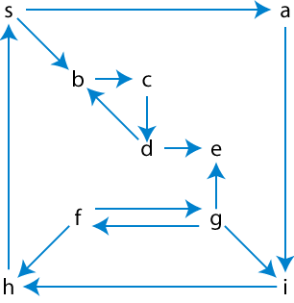
EXERCISE
Find the Strongly Connected Components usingTarjan’s SCC Algorithm

